Slide 1
Sellinger Applied Portfolio​
Portfolio Review |Summer 2019

Slide 2
TABLE OF CONTENTS
Overview
Economic Conditions
Sector Summaries
Portfolio Strategy & Composition
Growth
Value
Dividend
Risk Analysis
Performance Review
Student Biographies

Slide 3
overview
Summer 2019
Overview
Economic Conditions
Portfolio Strategy & Composition
Sector Summaries
Risk Analysis
Performance Review
Student Biographies

Slide 4
Sellinger Applied Portfolio Overview
Background
Process
The Student-Managed Sellinger Applied Portfolio Fund “SAP Fund” was established to provide students with actual portfolio management experience. Students are exposed to various aspects of the portfolio management process, including asset valuation, diversification, portfolio optimization, asset selection, risk management, performance evaluation, and rebalancing . Each year the University may provide the SAP Fund with up to $500,000 to invest. These funds are a component of the University’s endowment.
The faculty hand selects 8 eligible students to manage the Sellinger Applied Portfolio Fund each semester. Member participation stems from team formation to analyze and pitch stock recommendations for the fund to invest in. Members in their entirety then vote on wither the recommendations pass and are implemented into the fund.
Team Formation
Team Pitches
Current events
Stock analysis
Sector coverage assigned
Stock recommendations
Students vote on recommendations
Investment Voting

Slide 5
Economic Conditions
Summer 2019
Overview
Economic Conditions
Portfolio Strategy & Composition
Sector Summaries
Risk Analysis
Performance Review
Student Biographies

Slide 6
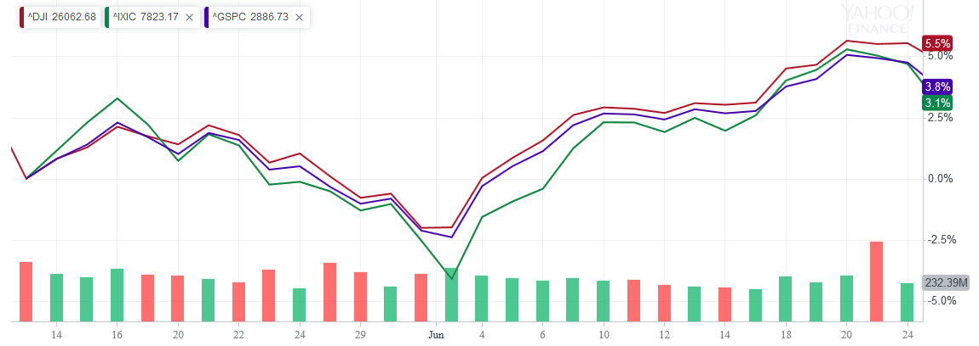
Market Overview
Major Indices - Returns Over the Investment Period Reflect Growth
Dow 30
+5.5%
NASDAQ
+3.8%
S&P 500
+3.1%

Slide 7
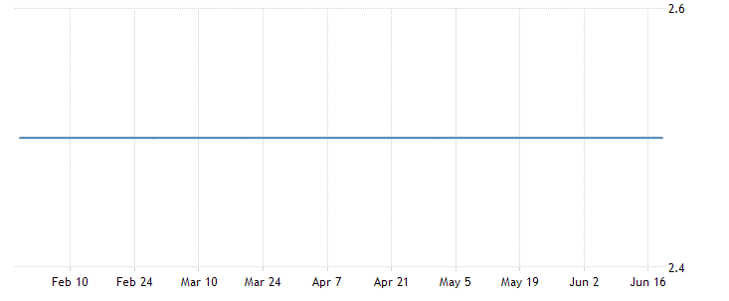
Federal Reserve Policy January – June Fed Funds Rate
Federal Open Market Committee (FOMC) Meeting 6/19/2019:
FOMC has agreed to maintain target range for the federal funds rate at 2-1/4 to 2-1/2 percent but dropped a promise to be "patient" in adjusting rates and signaled possible rate cuts of as much as half a percentage point later this year
Overall inflation and inflation for items other than food and energy are running below 2 percent.
https://www.federalreserve.gov/monetarypolicy/files/monetary20190619a1.pdf

Slide 8
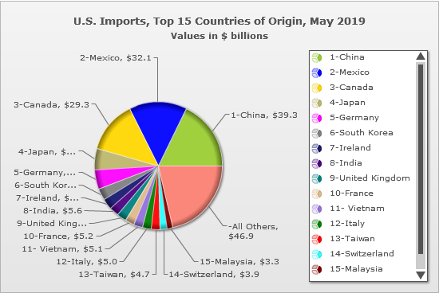
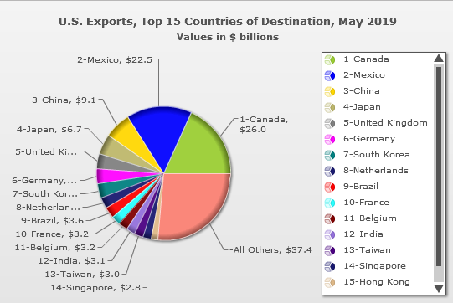
U.S. International Trade - May 2019
Despite tariffs, the overall Goods and Services Deficit increased to $55 billion (Imports of $266.2 billion and Exports of $210.6 billion)
Trade Deficit with China = $30.1 billion MTD
Trade Deficit with Mexico = $9.6 billion MTD

Slide 9
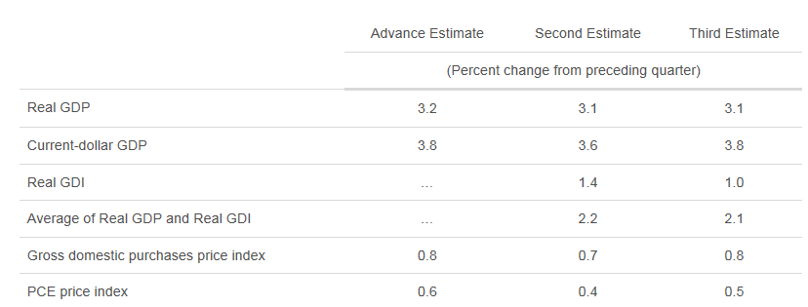
Real Gross Domestic Product Percent Change from Preceding Quarter
Real gross domestic product (GDP) increased at an annual rate of 3.1 percent in the first quarter of 2019
The increase in real GDP in the first quarter reflected positive contributions from exports, PCE, nonresidential fixed investment, private inventory investment, and state and local government spending that were slightly offset by a negative contribution from residential fixed investment.

Slide 10
U.S. Durable Goods Orders January – June 2019
Durable goods are expensive items that last three years or more.
Companies buy more durable goods when they feel confident about the economy and less when they are not sure.
Orders for durable goods fell 1.3% in May 2019. The decrease was driven by a 28.2% drop in new orders for commercial aircraft (Boeing 737 MAX). Orders for military aircraft fell by 15.3% and order for computers fell by 2.4%

Slide 11
Civilian Unemployment Rate
January – June 2019
Total Unemployment Rate Over the Investment Period:
May 2019
3.6%
June 2019
3.7%
Total Nonfarm Payroll Employment:
May 2019
+75k jobs
June 2019
+224k jobs
* Increase in professional and business services, health care, transportation and warehousing

Slide 12
Real Consumer Spending - Personal Income & Outlays May 2019 Update
Change from April to May 2019:
Personal income increased $88.6 billion (0.5 %)
Disposable personal income (DPI) increased$72.6 billion (0.5 %)
Personal consumption expenditures (PCE) increased $59.7 billion (0.4 %).
Real DPI increased 0.3 %
Real PCE increased 0.2 %
PCE price index increased 0.2%

Slide 13
Sector summaries
Summer 2019
Overview
Economic Conditions
Portfolio Strategy & Composition
Sector Summaries
Risk Analysis
Performance Review
Student Biographies

Slide 14
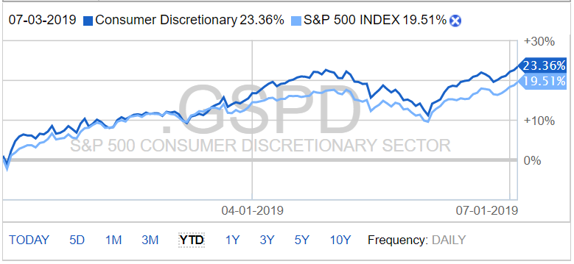
Consumer Discretionary
Performance (YTD):
23.36%
Portfolio Holdings:
Nike (NKE)
Walt Disney Co (DIS)
Vail Resorts, Inc. (MTN)
Estee Lauder Co Inc (EL)
Ford Motor Company (F)
Stocks to Watch:
Capri Holdings Ltd. (CPRI)
Amazon (AMZN)
The Consumer Discretionary sector consists of the companies which provide goods and services that are not considered necessities. It is split into four major industry groups: Automobiles and Components, Consumer Durables and Apparel, Consumer Services, and Retailing. These industries tend to be the most sensitive to economic cycles
-Growing economy
-Consumer confidence -Increased consumer spending -Improving job market
-Slowing economy
-Negative growth
-Trend of declining retail sales
-Inflation
-Shift towards online shopping

Slide 15
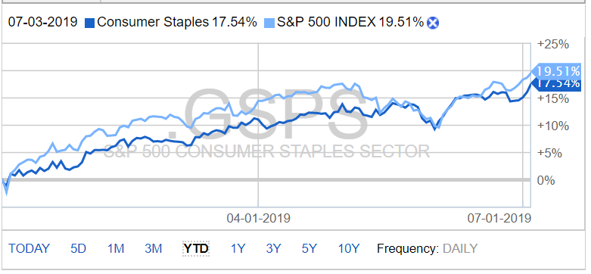
Consumer Staples
Performance (YTD):
17.54%
Portfolio Holdings:
Wal-Mart Stores Inc. (WMT)
Pepsi Co. (PEP)
Kroger (KO)
Target (TGT)
Stocks to Watch:
General Mills (GIS)
Conagra Brands (CAG)
Nu Skin Enterprises Inc. (NUS)
The Consumer Staples sector is split into food and staples retailing, household and personal products, food, beverage and tobacco. The businesses of this sector are inelastic to economic cycles, as the products of consumer staple sector are essential or necessary for basic living.
-Low cyclicality: a safe haven during periods of market volatility or economic downturn -Aggressive cost cutting
-Evolving preferences -Increased competition
-Government
restrictions

Slide 16
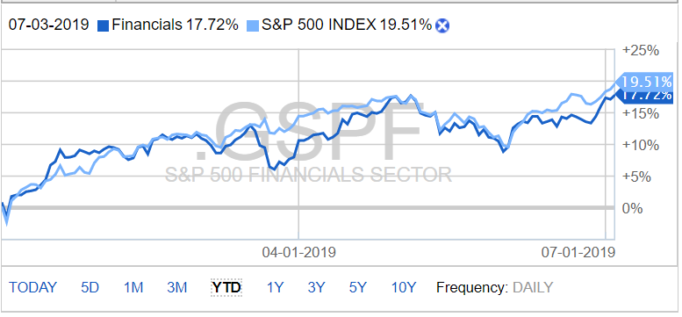
Financials
Performance (YTD):
17.72%
Portfolio Holdings:
Capital One (COF)
Morgan Stanley (MS)
MetLife (MET)
AllState (ALL)
Stocks to Watch:
Barclays PLC (BCS)
PNC Bank (PNC)
The Financials sector is comprised of firms that provide financial services to retail and commercial customers. This is broken up into seven industries that includes the following: banking, capital markets, consumer finance, diversified financial services, insurance, mortgage REITS and Thrifts and Mortgage Finance.
-Rising interest rates
-Technology enhancement
-Increase in artificial intelligence
-Subject to economic cycles
-Government policies and legislation
-Trade negotiations concerns

Slide 17
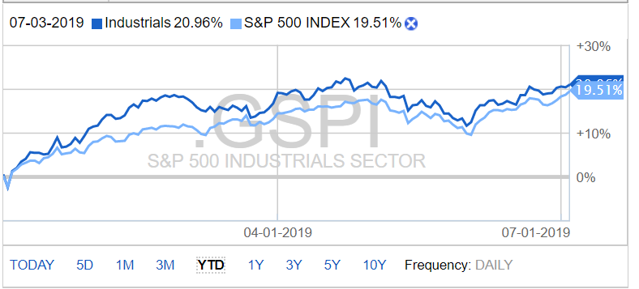
Industrials
Performance (YTD):
20.96%
Portfolio Holdings:
Royal Dutch Shell – A (RDS.A)
Hubbell Inc. (HUBB)
Delta A (DAL)
Stocks to Watch:
Xylem Inc. (XYL)
TPI Composites Inc. (TPIC)
Boeing (BA)
The Industrials sector consists of aerospace, defense, machinery, construction, fabrication and manufacturing companies. In general, the industry’s growth is driven by demand for building construction and manufactured products like agricultural equipment. The Industrials Sector is broken down into 3 industries: Commercial & Professional Services, Transportation and Capital Goods.
-Business globalization
-Direct network effect
-Lower Oil Cost
-Trades uncertainty
-International Competition
-Environmental Awareness

Slide 18
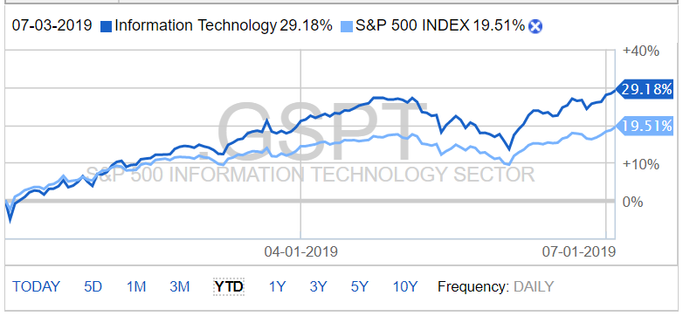
Information Technology
Performance (YTD):
29.18%
Portfolio Holdings:
Technology ETF (XLK)
Broadcom Inc (AVGO)
Zix Corp (ZIXI)
Applied Materials (AMAT)
Cerner (CERN)
Intel (INTC)
Microsoft (MSFT)
Take-Two Interactive (TTWO)
Adobe (ADBE)
Stocks to Watch:
Apple Inc. (AAPL)
Facebook (FB)
Twitter (TWTR)
The Information Technology sector is home to the hardware, software, computer equipment, and IT services operations. From microprocessors to printers, operating systems to cell phone handsets, recent advances in technology have turned IT into a giant part of the domestic and global economies. At present, the information technology sector contains six industries: Communications Equipment, Electronic Equipment, Instruments & Components, IT Services, Semiconductors & Semiconductor Equipment, Software and Technology Hardware, Storage & Peripherals Industry
-Artificial intelligence and cloud computing
-Increased
technology
spending
-Demand in IT security
-Increased
regulation
-Trade disputes
-Increased global competition

Slide 19
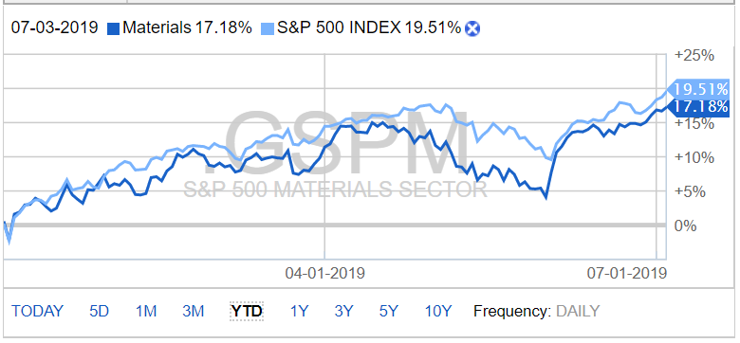
Materials
Performance (YTD):
17.18%
Portfolio Holdings:
Materials ETF (XLB)
Stocks to Watch:
DowDuPont (DD)
Ball Corporation (BLL)
The Materials sector consists of mining, refining, chemical, forestry and related companies that are focused on discovering and developing raw materials. Since these companies are at the beginning of the supply chain, they are vulnerable to changes in the business cycle.
-Demand for commodities
-Increase in mergers and acquisitions -Low unemployment
-Impacted by cyclical demand and volatility in raw material and energy prices
-Government interventions
-Exchange rate fluctuations

Slide 20
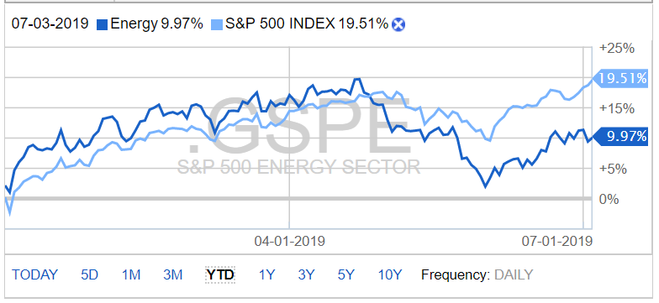
Energy
Performance (YTD):
9.97%
Portfolio Holdings:
Energy ETF (XLE)
Baker Hughes A GE CO CL A (BHGE)
Stocks to Watch:
Tesla (TSLA)
Exxon Mobil (XOM)
The Energy Sector consists of companies whose businesses are centered around the construction or provision of oil rigs, drilling equipment and other energy related service and equipment, including seismic data collection. The companies are also engaged in the exploration, production, marketing, refining and/or transportation of oil and gas products, coal and other consumable fuels. The Energy Sector is broken down into 2 industries: Energy Equipment & Services Industry and Oil, Gas & Consumable Fuels.
-Weather Forecasts
-Natural disasters
-Currency and pollical forces
-Increased Government regulations
-Energy price increase due to the potential war -Energy supply and demand for heating

Slide 21
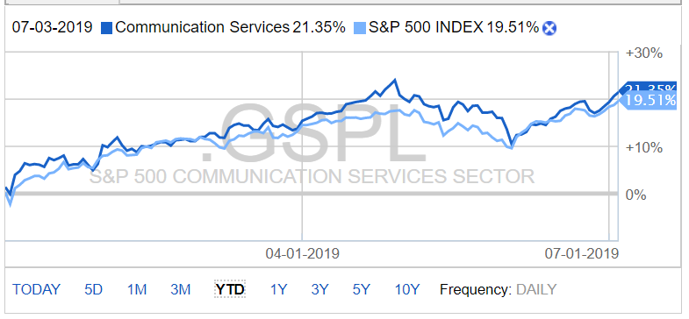
Telecommunications
Performance (YTD):
21.35%
Portfolio Holdings:
Communication Services ETF (XLC)
Comcast (CMCSA)
AT&T (T)
Stocks to Watch:
InterActive Corp (IAC)
Verizon (VZ)
The Telecommunications sector consists of companies that facilitate communication through telecommunications platforms and media services. The sector is split into four major categories including: Diversified Telecommunication Services, Entertainment, Interactive Media & Services, and Media.
-Increased demand
-Mergers and acquisition
-5G Network coverage
-Increase in artificial intelligence capabilities
-Increased competition
-Policy and regulation
-Risks in security breach

Slide 22
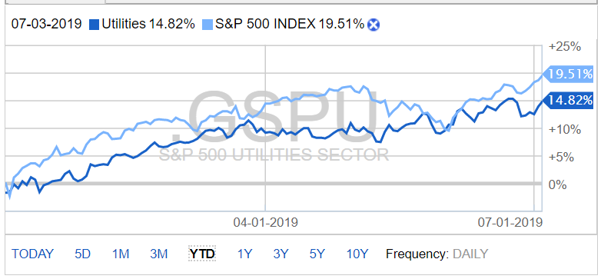
Utilities
Performance (YTD):
14.82%
Portfolio Holdings:
Utilities ETF (XLU)
Stocks to Watch:
NextEra Energy (NEE)
Aqua America (WTR)
The Utilities sector consists of electric, gas and water companies as well as integrated providers. In general, the sector generates consistent recurring income by charging consumers and businesses that provide higher-than-average dividend yields.
-Safe but limited growth potential -Increasing operational costs
-Weather forecast
-Sensitive to interest rate changes
-Government policy and regulation

Slide 23
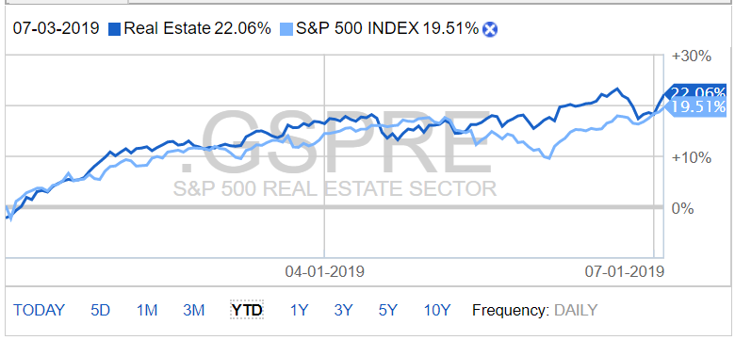
Real Estate
Performance (YTD):
22.06%
Portfolio Holdings:
WellTower Inc (WELL)
STORE Capital Corp (STOR)
Real Estate ETF (XLRE)
Stocks to Watch:
VICI Properties (VICI):
The Real Estate sector consists of companies invested in residential, industrial, and retail real estate. The main source of revenue for these companies comes from rent income and real estate capital appreciation, therefore this sector is sensitive to interest rate changes.
-Demographics
-Consumer confidence
-Health of economy
-Lower Interest rates
-Sensitive to interest rate changes
-Legislation determining
property demand and prices

Slide 24
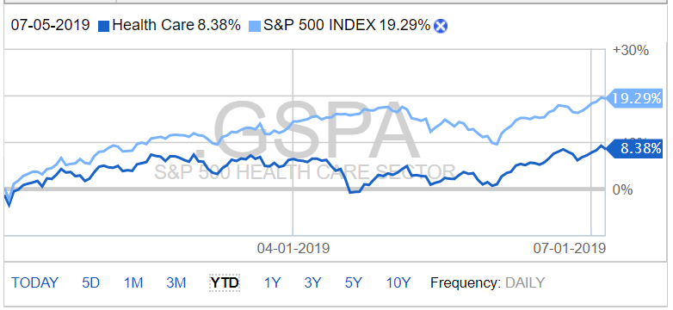
Healthcare
Performance (YTD):
8.38%
Portfolio Holdings:
None
Stocks to Watch:
Quest Diagnostics (DGX):
The Health Care sector encompasses two main industry groups. The first includes companies who manufacture health care equipment and supplies or provide health care related services, including distributors of health care products, providers of basic health-care services, and owners and operators of health care facilities and organizations. The second regroups companies primarily involved in the research, development, production and marketing of pharmaceuticals and biotechnology products.
-Strong demand for healthcare products and services
-Digital innovation and transformation advancement
-Healthcare reform
-Demographics
-Maintaining regulatory compliance and cyber security

Slide 25
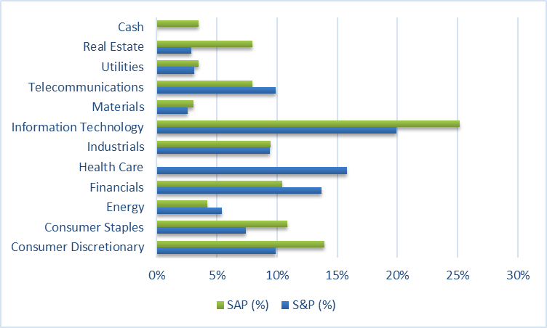
Sector Allocation
SAP vs. S&P 500
As of June 24, 2019

Slide 26
Portfolio strategy & composition
Summer 2019
Overview
Economic Conditions
Portfolio Strategy & Composition
Sector Summaries
Risk Analysis
Performance Review
Student Biographies

Slide 27
Growth Strategy Overview
To find stocks expected to grow faster than their industry peers
BUY CRITERIA
Conservative Mentality | Expect stock to perform better than the Industry
Revenue Growth | Industry Average and forecasted to continue to grow
Strong Earnings | 5 years of CAGR
ROE | ≥ 15% and > Industry Average
PEG | ≤ 1.2 and < Industry Average
Debt/Equity | < 1.5 (or Acceptable Interest Coverage Ratio when D/E >1.0)
SELL CRITERIA
Price | Price reaches 10% below target price or 20% above purchase price
Leadership | The company’s leadership position changes
Business Fundamentals | Business fundamentals deteriorate
Company slowdown | Slowing unit volume, revenue decline, weak earnings, etc.
Alternative Investments | Superior investment alternatives are identified

Slide 28
Summer 2019: Growth Acquisitions
Stop Loss Criteria
Acquisitions
20% Loss
Applied Materials Inc (NASDAQ: AMAT)
Broadcom Inc (NASDAQ: AVGO)
Zix Corporation (NASDAQ: ZIXI)

Slide 29
APPLIED MATERIALS (AMAT)
Date Purchased: | 05/22/2019
Number of Shares: | 250.00
Price/Share at time of purchase: | $40.35
Market Value at Purchase: | $10,087.50
BUY CRITERIA
Conservative Mentality | Expect stock to perform better than the Industry
Revenue Growth | Industry Average and forecasted to continue to grow
Strong Earnings | 5 years of CAGR
ROE | ≥ 15% and > Industry Average
PEG | ≤ 1.2 and < Industry Average
Debt/Equity | < 1.5 (or Acceptable Interest Coverage Ratio when D/E >1.0)
AMAT
YES
YES
18.1% (peers 7.3%)
45.7% (> peers)
< 1.2
0.6 (peers 0.4)
Applied Materials, founded in 1967, is organized into 3 major business segments: semiconductor systems, Applied Global Services, and Display and Adjacent Markets. Top-line growth at AMAT has grown significantly (90%) over the past 5 years and the company appears well positioned to grow further by serving the nascent but expanding Internet of Things (IoT) space over the coming years.

Slide 30
BROADCOM INC (AVGO)
Date Purchased: | 06/05/2019
Number of Shares: | 75.00
Price/Share at time of purchase: | $256.92
Market Value at Purchase: | $19,269.00
BUY CRITERIA
Conservative Mentality | Expect stock to perform better than the Industry
Revenue Growth | Industry Average and forecasted to continue to grow
Strong Earnings | 5 years of CAGR
ROE | ≥ 15% and > Industry Average
PEG | ≤ 1.2 and < Industry Average
Debt/Equity | < 1.5 (or Acceptable Interest Coverage Ratio when D/E >1.0)
AVGO
YES
YES
36.7%
26.5% (peers 22.5%)
0.9 (peers 1.55)
1.5 (peers 0.4)
Broadcom Inc is a semiconductor provider focused on two primary segments: Semiconductor Solutions and Infrastructure Software. Areas of focus include cloud computing, AI, and the Internet of Things (IoT). Based on current pricing and the general fear around tariff escalations, we feel AVGO represents a good growth target moving forward.

Slide 31
ZIX CORP (ZIXI)
Date Purchased: | 06/05/2019
Number of Shares: | 1,100.00
Price/Share at time of purchase: | $8.83
Market Value at Purchase: | $9,713.00
BUY CRITERIA
Conservative Mentality | Expect stock to perform better than the Industry
Revenue Growth | Industry Average and forecasted to continue to grow
Strong Earnings | 5 years of CAGR
ROE | ≥ 15% and > Industry Average
PEG | ≤ 1.2 and < Industry Average
Debt/Equity | < 1.5 (or Acceptable Interest Coverage Ratio when D/E >1.0)
ZIXI
YES
YES
7.9%
26.9% (peers 2.93%)
1.3% (peers 4.17%)
37% (peers 85.6%)
Zix Corporation provides email and database security and encryption for government and private industry, most notably in the Health Care sector. The company has previously teamed up with Google and Microsoft to provide integration of the Zix technology into popular email and browser platforms. With the increasing importance of personal information security, Zix looks well positioned to help serve this need.

Slide 32
Value Strategy Overview
To find stocks priced less than their intrinsic value
BUY CRITERIA
Price/Sales | < Industry Average
Price/Book | < Industry Average
Dividends | > Industry Average
Free Cash Flow | Positive
SELL CRITERIA
Merger or acquisitions | Any news in regards to M&A activity
Earnings | Significant restatement
Executive Management | Changes to management
Price Targets | Exceeds initial price target
Price | Trending downwards towards a stop loss mark

Slide 33
Summer 2019: Value Acquisitions
Stop Loss Criteria
Acquisitions
20% Loss
Allstate Corp (NYSE: ALL)
Baker Hughes (NYSE: BHGE)
Ford (NYSE: F)
Hubbell Inc (NYSE: HUBB)
Kroger Co (NYSE: KR)
Quest Diagnostics (NYSE: DGX)
PNC Bank (NYSE: PNC)

Slide 34
ALLSTATE CORP (ALL)
Date Purchased: | 06/13/2019
Number of Shares: | 150.00
Price/Share at time of purchase: | $100.41
Market Value at Purchase: | $15,061.50
BUY CRITERIA
Price/Sales | < Industry Average
Price/Book | < Industry Average
Dividends | > Industry Average
Free Cash Flow | Positive
ALL
0.8 (IndAvg 1.3)
1.5 (IndAvg 1.5)
2.0% (IndAvg 1.9%)
YES
Founded in 1931, in Northbrook, Illinois, Allstate has been a pioneer of the insurance industry. Americans have trusted Allstate to help protect their families and their belongings for over 80 years. Allstate is the nation's largest publicly held personal lines insurer. They offer a broad range of services including auto, life, property and annuities. This diversification insulates them from major setbacks in one service, unlike Geico who mainly does auto.

Slide 35
BAKER HUGHES (BHGE)
Date Purchased: | 06/03/2019
Number of Shares: | 500.00
Price/Share at time of purchase: | $21.77
Market Value at Purchase: | $10,885.00
BUY CRITERIA
Price/Sales | < Industry Average
Price/Book | < Industry Average
Dividends | > Industry Average
Free Cash Flow | Positive
BHGE
0.4 (IndAvg 1.1)
1.4 (IndAvg 1.4)
3.1% (IndAvg 3.0%)
YES
Baker Hughes and GE's oil and gas division offer a solution set that the combined company likes to describe as "fullstream." That means it can step in to help companies across the energy value chain, from upstream drilling activities (around 60% of revenues) through the midstream assets (25%), like pipelines, that move oil and gas, and all the way to the downstream businesses (5%) that refine them into usable products like gasoline and chemicals ("other" makes up the remainder of revenues).
As of December 2018 Baker Hughes is 50.4% owned by General Electric Company and 49.6% publicly traded.

Slide 36
FORD (F)
Date Purchased: | 06/13/2019
Number of Shares: | 1525.00
Price/Share at time of purchase: | $9.96
Market Value at Purchase: | $15,189.00
BUY CRITERIA
Price/Sales | < Industry Average
Price/Book | < Industry Average
Dividends | > Industry Average
Free Cash Flow | Positive
F
0.2 (IndAvg 0.4)
1.0 (IndAvg 1.1)
6.3% (IndAvg 2.4%)
YES
Ford currently stands with a dividend yield approximately 3X that of its peers and is attractively priced for an overall value strategy . From a product offering perspective, Ford is positioned as number one in high end trucks. With the continued lull in fuel costs, we anticipate the SUV and the truck market to continue to show strength, and for Ford to thus be well positioned to capitalize on this market trend .

Slide 37
HUBBELL INC (HUBB)
Date Purchased: | 5/22/2019
Number of Shares: | 90.62
Price/Share at time of purchase: | $119.6
Market Value at Purchase: | $10,843.59
BUY CRITERIA
Price/Sales | < Industry Average
Price/Book | < Industry Average
Dividends | > Industry Average
Free Cash Flow | Positive
HUBB
1.2 (IndAvg 2.3)
3.1 (IndAvg 3.1)
3.2% (IndAvg 0.5%)
YES
Hubbell Inc provides electrical infrastructure and component solutions to commercial and residential customers. The company has a well-diversified supply chain and customer base, and demand is projected to remain constant or increase over the next few years. Given the necessity of power infrastructure, Hubble is also relatively well insulated from tariff related pressure.

Slide 38
KROGER CO (KR)
Date Purchased: | 06/24/2019
Number of Shares: | 500.00
Price/Share at time of purchase: | $22.33
Market Value at Purchase: | $11,165.00
BUY CRITERIA
Price/Sales | < Industry Average
Price/Book | < Industry Average
Dividends | > Industry Average
Free Cash Flow | Positive
KR
0.2 (IndAvg 0.4)
2.5 (IndAvg 2.5)
2.3% (IndAvg 1.8%)
YES
At 121 Billion in sales, Kroger generates more revenue than many other, perhaps more well known, companies (for example, KR has higher annual sales than MS, BOA, Boeing, or Home Depot). Kroger operates 2,764 Supermarkets and 1,537 fuel centers and is the #1 food retailer in the country.

Slide 39
Quest Diagnostics (DGX)
BUY CRITERIA
Price/Sales | < Industry Average
Price/Book | < Industry Average
Dividends | > Industry Average
Free Cash Flow | Positive
DGX
1.9 (IndAvg 4.0)
2.6 (IndAvg 4.6)
2.0% (IndAvg 0.4%)
YES
Purchased after the close of the Summer 2019 session
Quest is the world’s leading provider of diagnostic information services and touches the lives of 30 percent of American adults each year. It serves about half of the physicians and hospitals in the U.S. and has access to approximately 90% of U.S. insured lives. Quest maintains more than 6,600 patient access points, the most extensive network in the U.S.

Slide 40
PNC Bank (PNC)
BUY CRITERIA
Price/Sales | < Industry Average
Price/Book | < Industry Average
Dividends | > Industry Average
Free Cash Flow | Positive
PNC
3.6 (IndAvg 3.5)
1.2 (IndAvg 1.3)
2.9% (IndAvg 2.7%)
YES
Purchased after the close of the Summer 2019 session
PNC Bank is #2 among superregional bans on Fortune’s list of the Most Admired Companies and is the highest-rated bank on Barron’s. largest minority ownership position (22%) in BlackRock, the world’s largest asset manager

Slide 41
Dividend Strategy Overview
To find stocks fairly priced and offering a Dividend yield greater than the S&P 500
BUY CRITERIA
Dividend Yield | ≥ SPDR S&P Dividend ETF
Quick Ratio | ≥ Industry Average
Cash Dividends | Positive total cash Dividends paid annually
Positive Total Cash | From investing and operating activiteis
Constant Dividend | Yes
Dividend Growth | Historical and potential Dividend growth
SELL CRITERIA
Dividends | Dividends are cut
Free Cash Flow | Diminishes or is no longer positive
Alternative Investments | Superior investment alternatives are identified

Slide 42
Summer 2019: Dividend Acquisitions
Stop Loss Criteria
Acquisitions
20% Loss
Store Capital (NYSE: STOR)
Vail Resorts (NYSE: MTN)

Slide 43
STORE CAPITAL (STOR)
Date Purchased: | 06/24/2019
Number of Shares: | 426
Price/Share at time of purchase: | $34.90
Market Value at Purchase: | $14,867.40
BUY CRITERIA
Dividend Yield | ≥ SPDR S&P Dividend ETF
Quick Ratio | ≥ Industry Average
Cash Dividends | Positive total cash Dividends paid annually
Positive Total Cash | From investing and operating activities
Constant Dividend | Yes
Dividend Growth | Historical and potential Dividend growth
STOR
4.5% (SPDR 2.5%)
N/A
YES
YES*
YES
YES
STORE Capital (Single Tenant Operational Real Estate) is a real estate company focused on REITs (real estate investment trusts). The company has exhibited strong growth and has a well-diversified portfolio of real estate holdings (2,000+ locations), spanning multiple industries and sectors. All holdings are within the United States, offering the company some insulation to tariff-related pressures.
*Positive operating cash flow; investing cash flow negative due to expansion of REITs holdings as function of growth.

Slide 44
VAIL RESORTS (MTN)
Date Purchased: | 06/03/2019
Number of Shares: | 45.00
Price/Share at time of purchase: | $215.72
Market Value at Purchase: | $9,707.40
BUY CRITERIA
Dividend Yield | ≥ SPDR S&P Dividend ETF
Quick Ratio | ≥ Industry Average
Cash Dividends | Positive total cash Dividends paid annually
Positive Total Cash | From investing and operating activities
Constant Dividend | Yes
Dividend Growth | Historical and potential Dividend growth
MTN
3.3% (SPDR 2.5%)
YES (0.69)
YES
YES*
YES
YES
Vail Resorts Inc. founded in 1962 is classified under the consumer discretionary sector. Vail is the premier mountain resort company in the world and a leader in luxury, destination-based travel at iconic locations. Locations found in Vail Resorts portfolio consist of Breckenridge, Keystone and Park City. Outside of their mountains, other operations include: lodging and real estate.
*Positive operating cash flow; investing cash flow negative due to expansion

Slide 45
Risk Analysis
Summer 2019
Overview
Economic Conditions
Risk Analysis
Sector Summaries
Portfolio Strategy & Composition
Performance Review
Student Biographies

Slide 46
Covariance Matrix
 | NKE | DIS | MTN | EL | F | WMT | PEP | KR | TGT | COF | MS | MET | ALL | RDS.A | HUBB | DAL | XLK | AVGO | ZIXI | AMAT | CERN | INTC | MSFT | TTWO | ADBE | XLB | XLE | BHGE | XLC | CMCSA | T | XLU | WELL | STOR | XLRE
NKE | 23.58
DIS | 19.83 | 94.09
MTN | -30.29 | -61.72 | 1156.92
EL | 12.99 | 33.76 | -140.37 | 37.69
F | 28.48 | 78.04 | -47.89 | 34.86 | 82.25
WMT | 12.03 | 36.85 | -59.65 | 22.10 | 34.46 | 26.11
PEP | 16.49 | 60.43 | -45.34 | 32.39 | 58.32 | 26.06 | 52.28
KR | -4.51 | -14.42 | 46.40 | -10.40 | -15.55 | -5.87 | -12.14 | 6.10
TGT | 12.85 | 19.50 | 132.01 | -8.85 | 26.09 | 12.19 | 10.33 | 0.61 | 51.33
COF | 7.10 | 13.89 | 194.49 | -19.46 | 15.83 | -1.23 | 5.13 | 4.79 | 37.88 | 49.49
MS | 28.48 | 78.04 | -47.89 | 34.86 | 82.25 | 34.46 | 58.32 | -15.55 | 26.09 | 15.83 | 82.25
MET | 7.23 | 13.52 | 15.03 | 3.31 | 13.86 | 5.61 | 8.27 | -1.17 | 9.77 | 10.20 | 13.86 | 5.46
ALL | 18.42 | 26.10 | 85.50 | 0.51 | 32.34 | 11.47 | 17.67 | -2.01 | 35.31 | 31.32 | 32.34 | 10.61 | 34.76
RDS.A | 5.47 | 3.90 | 55.91 | -6.92 | 6.93 | -1.55 | 1.40 | 0.16 | 14.36 | 16.25 | 6.93 | 4.02 | 12.78 | 9.05
HUBB | 35.27 | 35.97 | 115.30 | -0.09 | 52.38 | 13.22 | 23.30 | -3.66 | 49.69 | 46.92 | 52.38 | 17.39 | 51.02 | 20.94 | 97.21
DAL | 3.14 | 13.19 | 67.51 | -1.80 | 13.06 | 5.03 | 9.77 | 1.03 | 13.11 | 14.79 | 13.06 | 2.95 | 10.51 | 3.08 | 17.23 | 11.52
XLK | 17.22 | 27.77 | 46.59 | 4.73 | 33.97 | 10.54 | 20.73 | -4.03 | 24.48 | 22.10 | 33.97 | 8.02 | 25.19 | 9.90 | 41.15 | 9.42 | 22.80
AVGO | 100.37 | 158.48 | -735.4 | 141.09 | 182.61 | 89.59 | 134.55 | -53.51 | -34.71 | -85.21 | 182.61 | 15.35 | 17.77 | -12.28 | 78.82 | -1.26 | 55.45 | 1009.51
ZIXI | 3.34 | 10.45 | -24.63 | 7.45 | 9.41 | 5.32 | 8.28 | -2.18 | -0.78 | -1.96 | 9.41 | 1.44 | 1.83 | -0.61 | 2.36 | 0.36 | 2.40 | 30.84 | 2.06
AMAT | 12.20 | 13.06 | 55.86 | -0.25 | 16.65 | -0.77 | 12.64 | -1.34 | 12.98 | 19.28 | 16.65 | 6.08 | 17.66 | 9.08 | 27.12 | 4.80 | 15.76 | 15.77 | 1.03 | 21.30
CERN | 11.68 | 40.81 | 66.19 | 5.61 | 38.79 | 12.75 | 25.94 | -4.36 | 27.20 | 28.16 | 38.79 | 10.35 | 27.57 | 9.53 | 39.96 | 10.71 | 21.82 | 17.66 | 3.32 | 14.81 | 32.70
INTC | 9.02 | -0.25 | -24.03 | 3.35 | 5.09 | 1.10 | 4.07 | -1.70 | -0.64 | -2.89 | 5.09 | -0.15 | 2.15 | 1.93 | 6.69 | 0.01 | 5.66 | 58.08 | 0.47 | 6.81 | -3.98 | 12.38
MSFT | 28.48 | 78.04 | -47.89 | 34.86 | 82.25 | 34.46 | 58.32 | -15.55 | 26.09 | 15.83 | 82.25 | 13.86 | 32.34 | 6.93 | 52.38 | 13.06 | 33.97 | 182.61 | 9.41 | 16.65 | 38.79 | 5.09 | 82.25
TTWO | -18.08 | -26.03 | 394.94 | -61.71 | -24.53 | -23.38 | -37.20 | 17.90 | 60.50 | 76.24 | -24.53 | 7.52 | 30.46 | 23.39 | 41.23 | 16.97 | 11.76 | -332.0 | -11.50 | 9.00 | 29.38 | -24.58 | -24.53 | 209.35
ADBE | 66.87 | 114.84 | 18.95 | 44.60 | 136.10 | 49.29 | 86.39 | -20.84 | 66.34 | 55.14 | 136.10 | 29.65 | 79.24 | 27.49 | 133.95 | 24.93 | 74.85 | 278.80 | 14.18 | 47.50 | 75.00 | 16.02 | 136.10 | -0.66 | 296.83
XLB | 7.70 | 5.07 | 61.46 | -3.98 | 9.36 | 0.49 | 4.53 | 0.81 | 14.91 | 16.58 | 9.36 | 4.50 | 13.73 | 6.89 | 23.11 | 5.33 | 10.83 | -5.14 | -0.31 | 10.52 | 9.82 | 3.03 | 9.36 | 18.69 | 30.03 | 8.23
XLE | 4.09 | -13.56 | 146.95 | -24.47 | -6.71 | -10.66 | -12.93 | 6.52 | 24.95 | 31.64 | -6.71 | 4.05 | 18.76 | 13.88 | 31.78 | 6.80 | 12.19 | -78.64 | -4.30 | 13.02 | 9.38 | 2.33 | -6.71 | 56.51 | 19.78 | 12.25 | 31.48
BHGE | 4.07 | -13.38 | 102.44 | -18.22 | -6.22 | -9.16 | -11.29 | 4.27 | 19.10 | 22.05 | -6.22 | 2.67 | 14.72 | 10.19 | 23.91 | 3.05 | 8.91 | -59.90 | -3.42 | 10.58 | 6.53 | 1.92 | -6.22 | 41.41 | 14.16 | 9.12 | 22.87 | 18.53
XLC | 7.33 | 10.02 | 37.73 | -1.40 | 12.33 | 1.59 | 6.98 | -0.95 | 11.60 | 13.71 | 12.33 | 3.94 | 12.07 | 6.38 | 19.32 | 3.77 | 10.75 | 8.62 | 0.53 | 9.79 | 10.34 | 2.91 | 12.33 | 12.52 | 33.80 | 6.10 | 9.16 | 6.78 | 6.37
CMCSA | 8.19 | 23.23 | -34.21 | 13.84 | 23.03 | 11.89 | 18.80 | -4.84 | 2.93 | -0.50 | 23.03 | 3.13 | 6.20 | -0.34 | 9.81 | 3.63 | 7.86 | 67.86 | 3.46 | 2.92 | 8.18 | 2.58 | 23.03 | -20.18 | 34.44 | 0.91 | -6.06 | -5.39 | 2.17 | 8.30
T | 6.56 | 15.86 | -49.11 | 14.03 | 16.58 | 9.25 | 14.20 | -4.40 | -0.65 | -5.08 | 16.58 | 1.79 | 2.99 | -1.53 | 4.20 | 0.31 | 4.38 | 60.04 | 3.03 | 1.54 | 4.40 | 2.11 | 16.58 | -22.91 | 24.31 | -0.53 | -7.64 | -5.66 | 0.70 | 6.06 | 5.76
XLU | 6.31 | 17.42 | -35.74 | 13.16 | 18.46 | 9.67 | 15.63 | -4.49 | 1.60 | -2.79 | 18.46 | 1.91 | 4.59 | -0.95 | 6.52 | 1.65 | 5.67 | 55.20 | 2.86 | 1.78 | 6.05 | 1.99 | 18.46 | -20.10 | 26.74 | 0.20 | -6.27 | -4.89 | 1.14 | 6.42 | 5.59 | 6.13
WELL | 12.99 | 33.76 | -140.37 | 37.69 | 34.86 | 22.10 | 32.39 | -10.40 | -8.85 | -19.46 | 34.86 | 3.31 | 0.51 | -6.92 | -0.09 | -1.80 | 4.73 | 141.09 | 7.45 | -0.25 | 5.61 | 3.35 | 34.86 | -61.71 | 44.60 | -3.98 | -24.47 | -18.22 | -1.40 | 13.84 | 14.03 | 13.16 | 37.69
STOR | 6.56 | 15.86 | -49.11 | 14.03 | 16.58 | 9.25 | 14.20 | -4.40 | -0.65 | -5.08 | 16.58 | 1.79 | 2.99 | -1.53 | 4.20 | 0.31 | 4.38 | 60.04 | 3.03 | 1.54 | 4.40 | 2.11 | 16.58 | -22.91 | 24.31 | -0.53 | -7.64 | -5.66 | 0.70 | 6.06 | 5.76 | 5.59 | 14.03 | 5.76
XLRE | 6.28 | 12.87 | -17.28 | 9.44 | 14.40 | 6.70 | 12.05 | -3.00 | 2.95 | 0.66 | 14.40 | 2.35 | 5.46 | 0.52 | 8.29 | 1.84 | 5.82 | 40.32 | 2.15 | 3.90 | 5.82 | 2.15 | 14.40 | -12.00 | 24.79 | 1.66 | -2.59 | -2.03 | 2.03 | 4.74 | 4.09 | 4.24 | 9.44 | 4.09 | 3.51

Slide 47
Correlation Matrix
 | NKE | DIS | MTN | EL | F | WMT | PEP | KR | TGT | COF | MS | MET | ALL | RDS.A | HUBB | DAL | XLK | AVGO | ZIXI | AMAT | CERN | INTC | MSFT | TTWO | ADBE | XLB | XLE | BHGE | XLC | CMCSA | T | XLU | WELL | STOR | XLRE
NKE | 1.00
DIS | 0.42 | 1.00
MTN | -0.18 | -0.19 | 1.00
EL | 0.44 | 0.57 | -0.67 | 1.00
F | 0.65 | 0.89 | -0.16 | 0.63 | 1.00
WMT | 0.48 | 0.74 | -0.34 | 0.70 | 0.74 | 1.00
PEP | 0.47 | 0.86 | -0.18 | 0.73 | 0.89 | 0.71 | 1.00
KR | -0.38 | -0.60 | 0.55 | -0.69 | -0.69 | -0.46 | -0.68 | 1.00
TGT | 0.37 | 0.28 | 0.54 | -0.20 | 0.40 | 0.33 | 0.20 | 0.03 | 1.00
COF | 0.21 | 0.20 | 0.81 | -0.45 | 0.25 | -0.03 | 0.10 | 0.28 | 0.75 | 1.00
MS | 0.65 | 0.89 | -0.16 | 0.63 | 1.00 | 0.74 | 0.89 | -0.69 | 0.40 | 0.25 | 1.00
MET | 0.64 | 0.60 | 0.19 | 0.23 | 0.65 | 0.47 | 0.49 | -0.20 | 0.58 | 0.62 | 0.65 | 1.00
ALL | 0.64 | 0.46 | 0.43 | 0.01 | 0.60 | 0.38 | 0.41 | -0.14 | 0.84 | 0.76 | 0.60 | 0.77 | 1.00
RDS.A | 0.37 | 0.13 | 0.55 | -0.37 | 0.25 | -0.10 | 0.06 | 0.02 | 0.67 | 0.77 | 0.25 | 0.57 | 0.72 | 1.00
HUBB | 0.74 | 0.38 | 0.34 | 0.00 | 0.59 | 0.26 | 0.33 | -0.15 | 0.70 | 0.68 | 0.59 | 0.75 | 0.88 | 0.71 | 1.00
DAL | 0.19 | 0.40 | 0.58 | -0.09 | 0.42 | 0.29 | 0.40 | 0.12 | 0.54 | 0.62 | 0.42 | 0.37 | 0.53 | 0.30 | 0.51 | 1.00
XLK | 0.74 | 0.60 | 0.29 | 0.16 | 0.78 | 0.43 | 0.60 | -0.34 | 0.72 | 0.66 | 0.78 | 0.72 | 0.89 | 0.69 | 0.87 | 0.58 | 1.00
AVGO | 0.65 | 0.51 | -0.68 | 0.72 | 0.63 | 0.55 | 0.59 | -0.68 | -0.15 | -0.38 | 0.63 | 0.21 | 0.09 | -0.13 | 0.25 | -0.01 | 0.37 | 1.00
ZIXI | 0.48 | 0.75 | -0.50 | 0.84 | 0.72 | 0.73 | 0.80 | -0.61 | -0.08 | -0.19 | 0.72 | 0.43 | 0.22 | -0.14 | 0.17 | 0.07 | 0.35 | 0.68 | 1.00
AMAT | 0.54 | 0.29 | 0.36 | -0.01 | 0.40 | -0.03 | 0.38 | -0.12 | 0.39 | 0.59 | 0.40 | 0.56 | 0.65 | 0.65 | 0.60 | 0.31 | 0.72 | 0.11 | 0.16 | 1.00
CERN | 0.42 | 0.74 | 0.34 | 0.16 | 0.75 | 0.44 | 0.63 | -0.31 | 0.66 | 0.70 | 0.75 | 0.77 | 0.82 | 0.55 | 0.71 | 0.55 | 0.80 | 0.10 | 0.40 | 0.56 | 1.00
INTC | 0.53 | -0.01 | -0.20 | 0.16 | 0.16 | 0.06 | 0.16 | -0.20 | -0.03 | -0.12 | 0.16 | -0.02 | 0.10 | 0.18 | 0.19 | 0.00 | 0.34 | 0.52 | 0.09 | 0.42 | -0.20 | 1.00
MSFT | 0.65 | 0.89 | -0.16 | 0.63 | 1.00 | 0.74 | 0.89 | -0.69 | 0.40 | 0.25 | 1.00 | 0.65 | 0.60 | 0.25 | 0.59 | 0.42 | 0.78 | 0.63 | 0.72 | 0.40 | 0.75 | 0.16 | 1.00
TTWO | -0.26 | -0.19 | 0.80 | -0.69 | -0.19 | -0.32 | -0.36 | 0.50 | 0.58 | 0.75 | -0.19 | 0.22 | 0.36 | 0.54 | 0.29 | 0.35 | 0.17 | -0.72 | -0.55 | 0.13 | 0.36 | -0.48 | -0.19 | 1.00
ADBE | 0.80 | 0.69 | 0.03 | 0.42 | 0.87 | 0.56 | 0.69 | -0.49 | 0.54 | 0.45 | 0.87 | 0.74 | 0.78 | 0.53 | 0.79 | 0.43 | 0.91 | 0.51 | 0.57 | 0.60 | 0.76 | 0.26 | 0.87 | 0.00 | 1.00
XLB | 0.55 | 0.18 | 0.63 | -0.23 | 0.36 | 0.03 | 0.22 | 0.11 | 0.73 | 0.82 | 0.36 | 0.67 | 0.81 | 0.80 | 0.82 | 0.55 | 0.79 | -0.06 | -0.08 | 0.80 | 0.60 | 0.30 | 0.36 | 0.45 | 0.61 | 1.00
XLE | 0.15 | -0.25 | 0.77 | -0.71 | -0.13 | -0.37 | -0.32 | 0.47 | 0.62 | 0.80 | -0.13 | 0.31 | 0.57 | 0.82 | 0.57 | 0.36 | 0.45 | -0.44 | -0.53 | 0.50 | 0.29 | 0.12 | -0.13 | 0.70 | 0.20 | 0.76 | 1.00
BHGE | 0.19 | -0.32 | 0.70 | -0.69 | -0.16 | -0.42 | -0.36 | 0.40 | 0.62 | 0.73 | -0.16 | 0.27 | 0.58 | 0.79 | 0.56 | 0.21 | 0.43 | -0.44 | -0.55 | 0.53 | 0.27 | 0.13 | -0.16 | 0.66 | 0.19 | 0.74 | 0.95 | 1.00
XLC | 0.60 | 0.41 | 0.44 | -0.09 | 0.54 | 0.12 | 0.38 | -0.15 | 0.64 | 0.77 | 0.54 | 0.67 | 0.81 | 0.84 | 0.78 | 0.44 | 0.89 | 0.11 | 0.15 | 0.84 | 0.72 | 0.33 | 0.54 | 0.34 | 0.78 | 0.84 | 0.65 | 0.62 | 1.00
CMCSA | 0.59 | 0.83 | -0.35 | 0.78 | 0.88 | 0.81 | 0.90 | -0.68 | 0.14 | -0.02 | 0.88 | 0.46 | 0.37 | -0.04 | 0.35 | 0.37 | 0.57 | 0.74 | 0.84 | 0.22 | 0.50 | 0.25 | 0.88 | -0.48 | 0.69 | 0.11 | -0.37 | -0.43 | 0.30 | 1.00
T | 0.56 | 0.68 | -0.60 | 0.95 | 0.76 | 0.75 | 0.82 | -0.74 | -0.04 | -0.30 | 0.76 | 0.32 | 0.21 | -0.21 | 0.18 | 0.04 | 0.38 | 0.79 | 0.88 | 0.14 | 0.32 | 0.25 | 0.76 | -0.66 | 0.59 | -0.08 | -0.57 | -0.55 | 0.12 | 0.88 | 1.00
XLU | 0.52 | 0.73 | -0.42 | 0.87 | 0.82 | 0.76 | 0.87 | -0.74 | 0.09 | -0.16 | 0.82 | 0.33 | 0.31 | -0.13 | 0.27 | 0.20 | 0.48 | 0.70 | 0.81 | 0.16 | 0.43 | 0.23 | 0.82 | -0.56 | 0.63 | 0.03 | -0.45 | -0.46 | 0.18 | 0.90 | 0.94 | 1.00
WELL | 0.44 | 0.57 | -0.67 | 1.00 | 0.63 | 0.70 | 0.73 | -0.69 | -0.20 | -0.45 | 0.63 | 0.23 | 0.01 | -0.37 | 0.00 | -0.09 | 0.16 | 0.72 | 0.84 | -0.01 | 0.16 | 0.16 | 0.63 | -0.69 | 0.42 | -0.23 | -0.71 | -0.69 | -0.09 | 0.78 | 0.95 | 0.87 | 1.00
STOR | 0.56 | 0.68 | -0.60 | 0.95 | 0.76 | 0.75 | 0.82 | -0.74 | -0.04 | -0.30 | 0.76 | 0.32 | 0.21 | -0.21 | 0.18 | 0.04 | 0.38 | 0.79 | 0.88 | 0.14 | 0.32 | 0.25 | 0.76 | -0.66 | 0.59 | -0.08 | -0.57 | -0.55 | 0.12 | 0.88 | 1.00 | 0.94 | 0.95 | 1.00
XLRE | 0.69 | 0.71 | -0.27 | 0.82 | 0.85 | 0.70 | 0.89 | -0.65 | 0.22 | 0.05 | 0.85 | 0.54 | 0.49 | 0.09 | 0.45 | 0.29 | 0.65 | 0.68 | 0.80 | 0.45 | 0.54 | 0.33 | 0.85 | -0.44 | 0.77 | 0.31 | -0.25 | -0.25 | 0.43 | 0.88 | 0.91 | 0.92 | 0.82 | 0.91 | 1.00

Slide 49
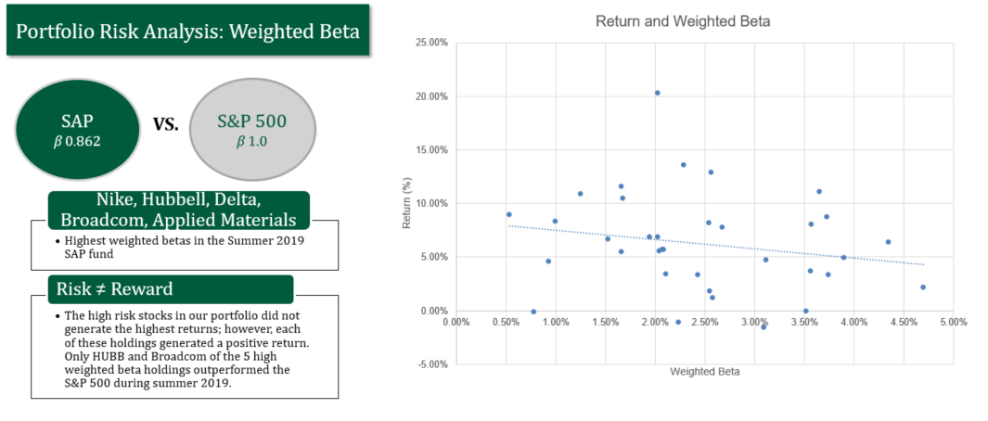

Slide 50
Performance
Summer 2019
Overview
Economic Conditions
Performance Review
Sector Summaries
Portfolio Strategy & Composition
Risk Analysis
Student Biographies

Slide 51
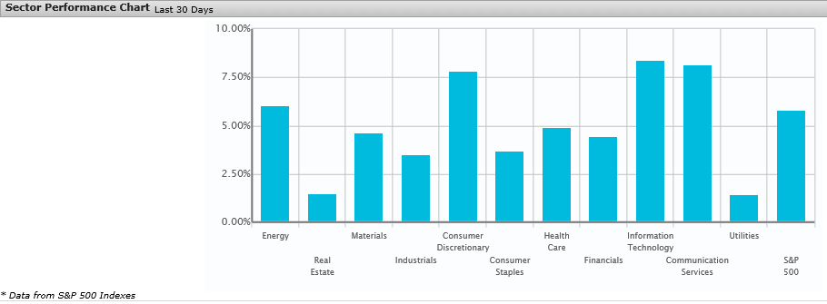
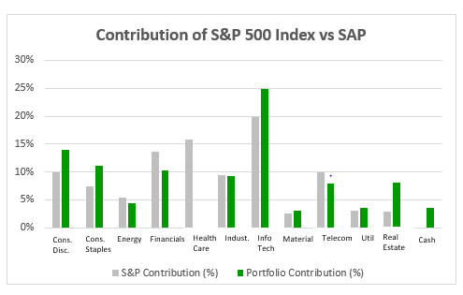
Portfolio Performance Summer Semester 2019
S&P 500
3.1%
SAP
6.3%
Source: S&P Capital IQ.
Performance as of: (05/13/2019) – (6/24/2019)
Performance Difference
The bottom graph depicts the performance difference relative to the benchmark. Our portfolio outperformed the S&P 500 by over 300 bps. Overall stock selection was supportive of the outperformance.

Slide 52
Portfolio Allocation

Slide 53
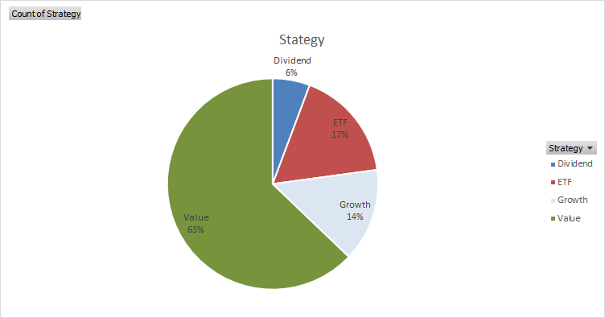
Portfolio Allocation

Slide 54
Performance Attribution
As of June 24th, 2019
Top Stock Selections for the Summer
Underperforming Selections
BHGE | Baker Hughes A GE CO CL A
KR | Kroger Co
AVGO | Broadcom Inc
STOR | Store Capital Corp
F | Ford Motor Company
ZIXI |Zix Corp
MTN | Vail Resorts Inc
ALL | Allstate
AMT |Applied Materials

Slide 55
Performance Returns

Slide 56
Top Outperformers
BHGE | Baker Hughes A GE CO CL A
Position
500 Shares | $ 12,360.00
Baker Hughes was purchased for the portfolio June 3rd and we have seen a strong performance by this company. We have a 13.55% return on this stock.
The stock price is down YTD but it is moving in the right direction as the price of oil continues to increase. The price for crude oil on June 3rd was $53.25/ barrel and the price on June 24th was $57.90/barrel.
General Electric is working on disposing of its stake in Baker Hughes, a GE company, and gradually exit its oil and gas business.

Slide 57
Top Outperformers
AVGO | Broadcom Inc
Position
75 Shares | $20,940.00
The volatility of the stock prices reflects the uncertainties that we experienced from the trade war with China because Broadcom has a huge Chinese exposure.
Broadcom supplies chips and other tech products to Huawei. The US government labeled this company as a national threat and placed restrictions on firms selling chips to the Chinese based company.
After the G20 Summit, President Trump hinted that he will potentially remove some of the restrictions on suppliers doing business with Huawei which was seen as a positive by the market.
Broadcom announced its intention to purchase cybersecurity company Symantec Corp. in an all-cash deal valued at ~16 billion dollars.

Slide 58
Top Outperformers
ZIXI |Zix Corp
Position
1,100 Shares | $ 10,516.00
Zix Corporation provides email encryption, data loss prevention , and Bring-Your-Own-Device (BYOD) security solutions to the healthcare, financial services, insurance, and government sectors in the United States.
This stock will continue to perform well if they are able to deliver high quality service to their customers because everyone is focused on cybersecurity.
Many analyst expects revenues to increase in the future based on higher demand for Zix’s services.

Slide 59
Top Outperformers
MTN | Vail Resorts Inc
MTN, the leading ski resort in the U.S. enrolled a plan to use its technology to gain more season pass holders, increasing stickier revenue streams for the firm.
The company continue to expand its footprint in the ski industry, recently announcing the launch of more trails and square footage at a Colorado location.
The share price took a significant march upwards after it reported stronger than expected earnings and raised its outlook, citing stronger growth in some of its premier resorts after originally anticipating weaker revenue due to a warmer season.
We continue to see strong upside and a fair value price just above $245. Management continues to display confidence in a long-term strategy that should provide stronger growth in the future.
Position
45 Shares | $ 10,255.05

Slide 60
Top Outperformers
AMT |Applied Materials
Position
250 Shares | $ 10,582.50
Applied Materials, has been affected by a bevy of news related to tariffs and the Chinese firm Huawei. It has outperformed over the period, but has seen more volatility than most stocks.
The share price did increase after it beat its latest earnings projections. The company sighted no revisions to its outlook for 2019 and anticipated higher growth back to double digits would resume in 2020 after the market debates the shift on the demand in memory.
The stock price still seems to be discounted, in part due to the December beatdown on semi and tech stocks. There seems to be room to run. The company announced plans to acquire Kokusai Electric. A reduction in tariffs with China could cause a significant boost to the share price.

Slide 61
Top Underperformers
KR | Kroger Co
Position
500 Shares | $ 11,040.00
Kroger was recommended on the 19th after a pullback in its share price over the last few years. Although the actual purchase was made on the 24th, the firm continued to see its share price decline significantly.
The street continues to believe that management will not be able to execute on its plan. The company continues to report that digital sales are helping the firm add more growth, although tepid at best. The company reported just above earnings estimates.
We continue to believe the company is undervalued and have confidence that management can deliver low to moderate growth over the next few quarters.

Slide 62
Top Underperformers
STOR | Store Capital Corp
Position
426 Shares | $ 14,841.84
STOR Capital, was mainly recommended on its ability to produce a consistent dividend. The company was recommended on the 19th, but the buy was not initiated until the 24th of June. The share price dipped during that time after a slight spike on 6/20.
Less worry should be placed on capital gains considering the dividend yield of over 4%. REIT's to a large degree must pay out their dividends and cannot skip them like other firms have the luxury to do.
The firm is one of the largest and fastest growing net lease REIT's in the United States.

Slide 63
Top Underperformers
F | Ford Motor Company
Position
1,525 Shares | $ 15,173.75
On the close of 6/24, Ford was trading at just below $10. As of 7/8, the share price has climbed to over $10. Ford's sales slowed on its most popular brand of F-series trucks. The company is continuing to shift toward production of EV's while retaining its production of pickups and larger SUV's, completely getting out of the sedan business.
The consensus on Ford has been mixed as the company remains highly leveraged. The company does have the brand recognition to enter the EV landscape so it will be intriguing to see how quickly consumers adopt the shift in the company's image.
Ford is continuing to invest heavily in technology, which should help generate a rosier picture in the mid to long-term.

Slide 64
Top Underperformers
ALL | Allstate
Position
150 Shares | $ 15,328.50
Allstate was purchased on 6/13 at a value over 15k. Allstate traded flat until close of business 24th, when it got a small boost. The share price is currently trading at levels past $104.
The company is one of the largest U.S insurers currently publicly traded. The business is diversified and is looking at ways to bolster its technology as efficiency will continue to help the company cut costs and drive margins higher in the future.
The company has continued to increase its divided per share as well, in addition to the YTD performance of over 26%.

Slide 65
Student biographies
Summer 2019
Overview
Economic Conditions
Portfolio Strategy & Composition
Sector Summaries
Risk Analysis
Performance Review
Student Biographies

Slide 66
Biographies
Shlomo is a graduate student pursuing a Master's of Science in Finance. Shlomo obtained his doctorate in Talmudic Law from Ner Israel Rabbinical College. Shlomo passed level 1 of the CFA program. Upon completion of the MSF, he plans to look for opportunities in finance.
Shlomo Bergmann

Slide 67
Biographies
Josh is a graduate student pursuing a Master of Business Administration (MBA) degree with a concentration in investments and applied portfolio management. Josh obtained his bachelor’s degree in Aerospace and Mechanical Engineering from the University of Virginia and currently works as a project engineer for Textron Systems Unmanned Systems located in Hunt Valley, MD. He plans to pursue new opportunities in either investment management or business management upon completion of the MBA program.
Josh Coiner

Slide 68
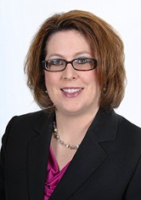
Biographies
Dianna is a graduate student pursuing a Master of Science in Finance (MSF) degree. Dianna obtained her bachelor’s degree in Accounting from Towson University and currently works as Director of Accounting for Textron Systems Unmanned Systems located in Hunt Valley, MD. Upon completion of the MSF program, she plans to continue her career in Accounting.
Dianna Davey

Slide 69
Biographies
Mack is a graduate student pursuing a Master of Science in Finance (MSF) degree. Mack obtained his bachelor’s degree in economics from Elon University in North Carolina. Mack works as a Senior Vice President of Commercial Lending at Sandy Spring Bank. Upon completion of the MSF program, he plans to continue his career in banking.
Mack Gilmor

Slide 70
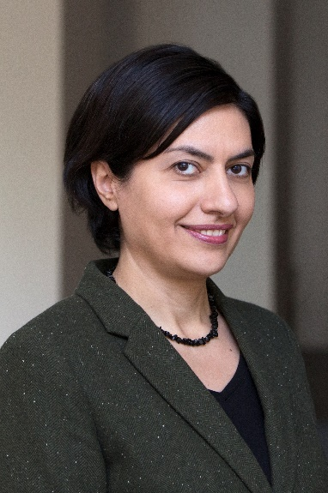
Biographies
Kristine is a graduate student pursuing a Master of Science in Finance (MSF) degree. Kristine obtained her bachelor’s degree in Engineering from State Engineering University, Armenia. Later, she obtained her MBA from University of Bradford, UK. Kristine works as Director of Overseas Finance Operations at Catholic Relief Services. Upon completion of the MSF program, she plans to continue her career in finance.
Kristine Ivanyan

Slide 71
Biographies
Brandon is a graduate student pursuing a Master of Business Administration (MBA) degree with a concentration in Finance. Brandon obtained his bachelors degree in Business Administration from Bucknell University. He currently works at Morgan Stanley as a Trading assistant on their Fixed Income trading desk. Upon completion of the MBA program, he plans to continue his career in finance while looking for opportunities within the front office.
Brandon Pinnock

Slide 72
Biographies
Greg is a graduate student pursuing a Master of Science in Finance (MSF) degree. Greg obtained his bachelor's degree in Life Science from Penn State University and currently works as an Assay R&D Manager for Becton Dickinson located in Sparks, MD. Upon completion of the MSF program, he plans to pursue opportunities related to Business and Technology Development within the Life Science field.
Greg Richart

Slide 73
John is a graduate student pursuing a Master's of Science in Finance. John obtained his bachelor's degree in Business Administration with a concentration in Finance from Towson University. He has passed level 1 of the CFA program. He currently works at T. Rowe Price as an Investment Liaison Specialist. Upon completion of the MSF, he plans to continue his career in finance in the investment track, pursuing a career path as a buy-side analyst.
John Rohrs

